Slide 1
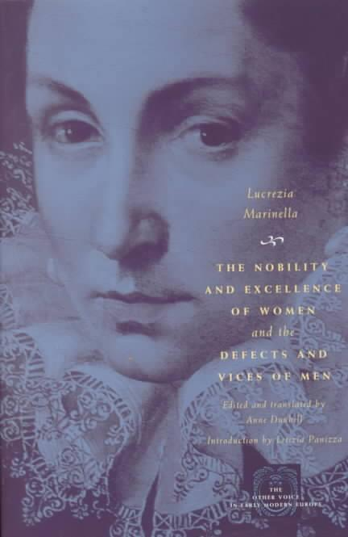
The Nobility and Excellence of Women and the Defects and Vices of Men Luzcrezia Marinella Pages 119-183
Presentation by: Brittany Anderson and Carol Tang

Slide 2
Small Group Questions
Marinella responds harshly to Aristotle for his words regarding women and heat. Using what we have previously learned about women, men, temperature and the argument she provides analyze her argument against Aristotle. (p. 130)
Marinella discusses the male version of adornment and argues that it is impossible to find a man “who does not swagger and play the Daredevil.” (167) What connections do you see between her argument and Vives’ view on adornment for women?
Throughout the second part of the book, Marinella quotes men and then denounces them with her argument. How do you think Marinella's argument strategy holds up? (p.132)
Why do you think that Marinella switches from denouncing Aristotle to using him as a source of support for her argument? (p. 137)

Slide 3
Large Group Discussion
Do you think that Marinella advocates equality between the sexes? Is she happy with being place on a pedestal or do you believe that this is a reflection of her social class?
Where does Marinella believe all womens bad deeds come from? If women are indeed corrupted by men, do you think that Marinella would see merit in Vives’ argument that women should be kept away from men as much as possible? (p. 128)

